Slide 1



ACLED Protest & Violence in Indonesia
(2015-2019)
Athollah Iqbal S. 14417006
M. Naufal F. Sahab 14417021
Faris Maulana A. 14417036
Dhiya’ Rafiq A. 14417044

Slide 2

OUTLINE
01
Background
02
Pre-Processing
03
Processing
04
Insights

Slide 3


01. Background
Feeling safe is one important factor that everybody needs. Protest and violence is some factors that can cause fear and loss for the society. There are many types of protest and violence that happens in Indonesia. It is important to identify, map, and collect insight from historical data to deeply understand the real situation is.
ACLED Protest & Violence in Indonesia (2015-2020)
Source: Kaggle.com
https://www.kaggle.com/aankasman/acled-protests-violence-in-indonesia-20152019

Slide 4
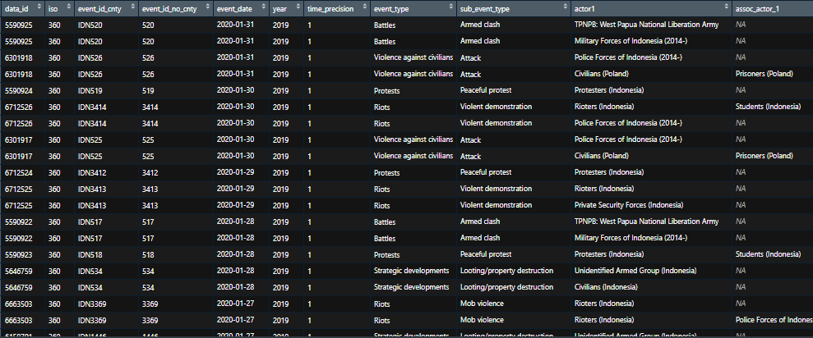
Data Display

Slide 5
Initial Data Type
No. | Variable | Data Type | No. | Variable | Data Type
1. | Data_ID | integer | 15. | country | character
2. | ISO | interger | 16. | admin1 | character
3. | Event_id_cnty | character | 17. | admin2 | character
4. | Event_ide_No_cnty | integer | 18. | admin3 | character
5. | Event_Date | date | 19. | location | character
6. | Year | integer | 20. | latitude | numerik
7. | Time precision | character | 21. | longitude | numerik
8. | Event_type | character | 22. | Geo_precise | integer
9. | Sub_event_type | character | 23. | source | character
10. | actor1 | character | 24. | Source_scale | character
11. | Assoc_actor1 | character | 25. | notes | character
12. | inter1 | integer | 26. | fatalities | integer
13. | interaction | integer | 27 | timestamp | integer
14. | region | character | 28. | iso3 | character

Slide 6
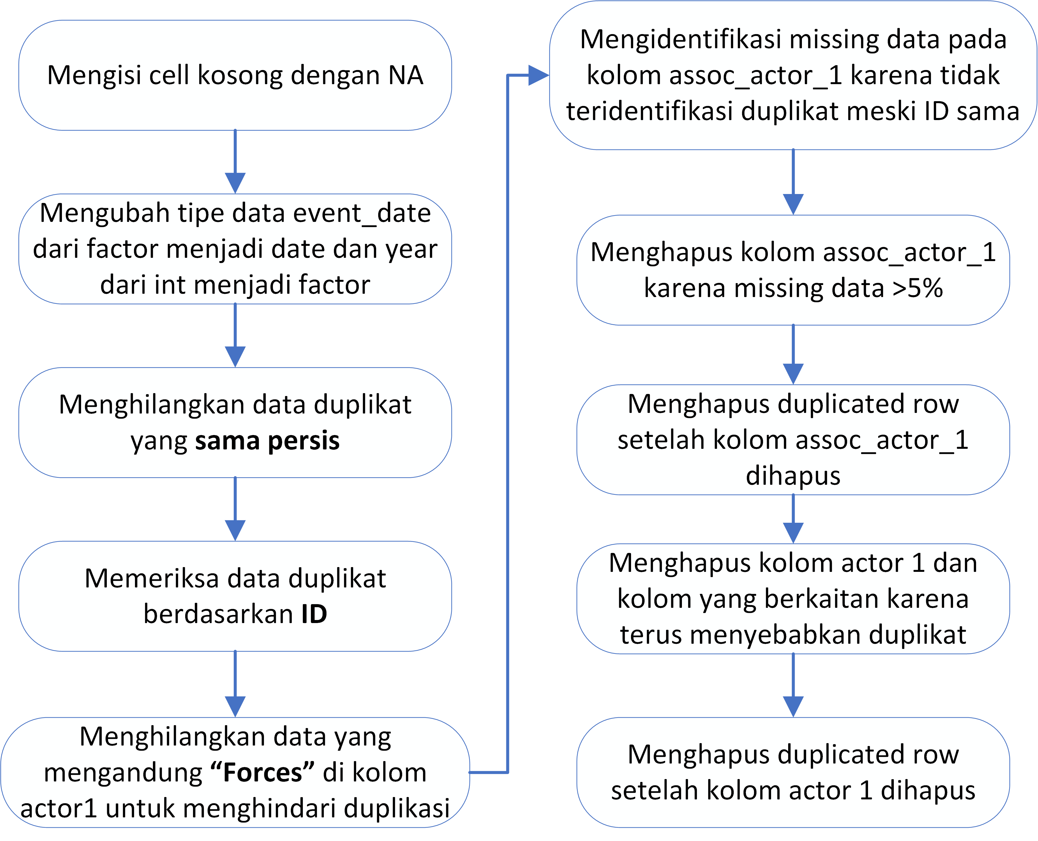
02. Pre-Processing

Slide 7
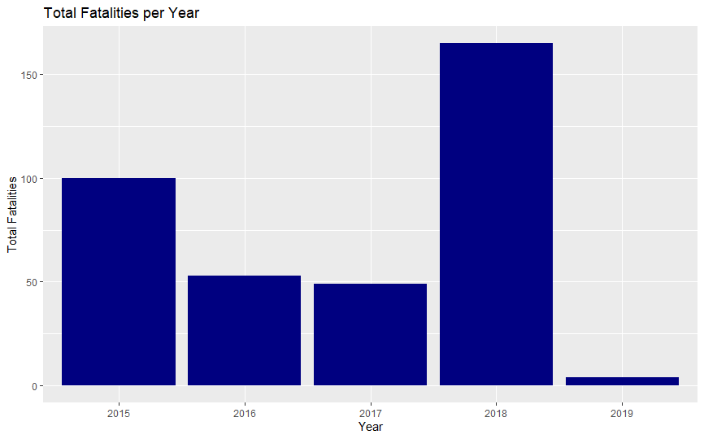
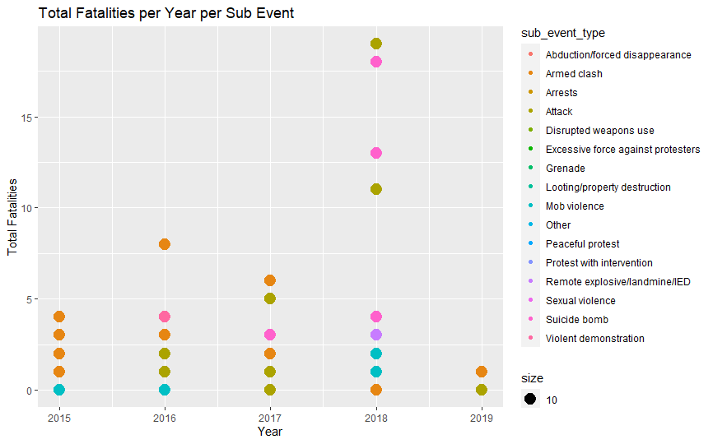
03. Processing – Jumlah Fatalities
Peningkatan jumlah fatalities terjadi pada tahun 2018, akibat suicide bomb

Slide 8
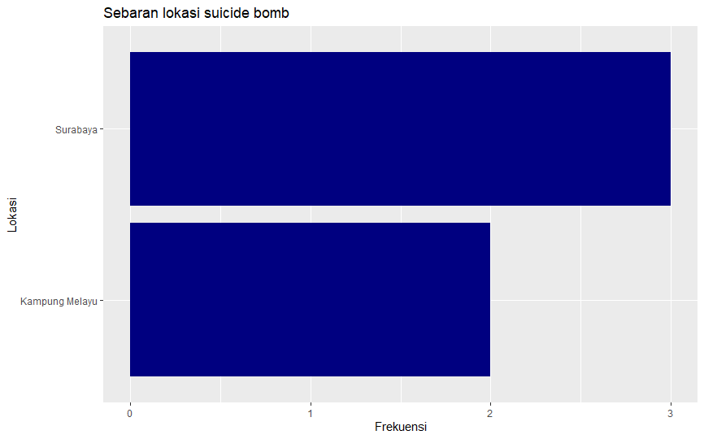
03. Processing – Lokasi Rawan Fatalities

Slide 9
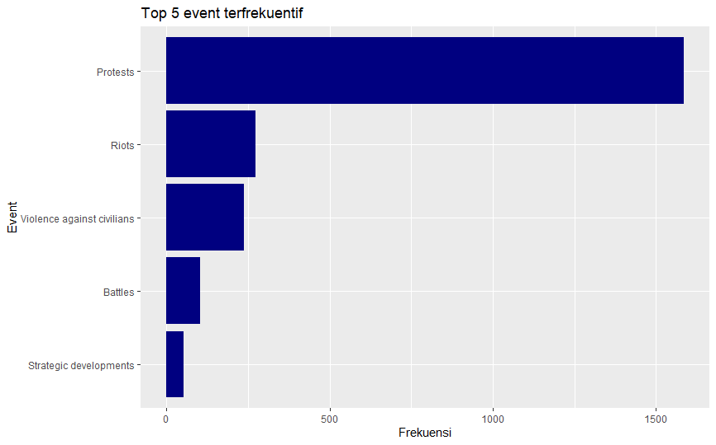
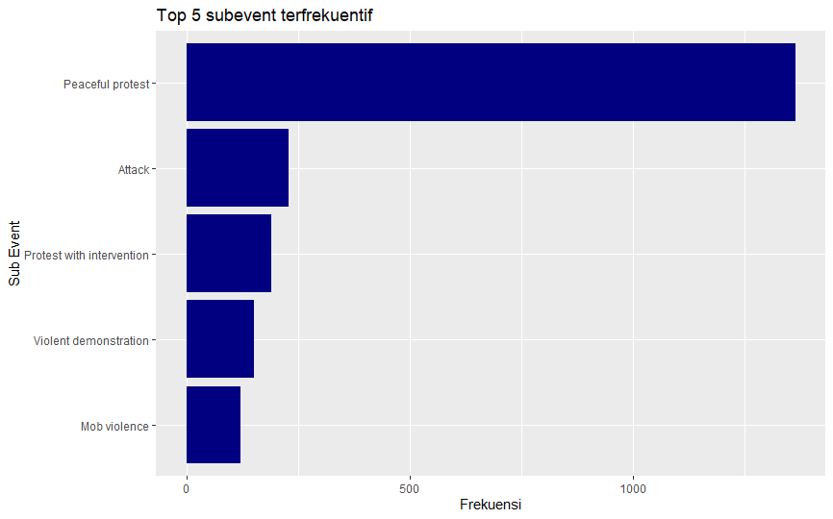
03. Processing – Jumlah Kasus

Slide 10
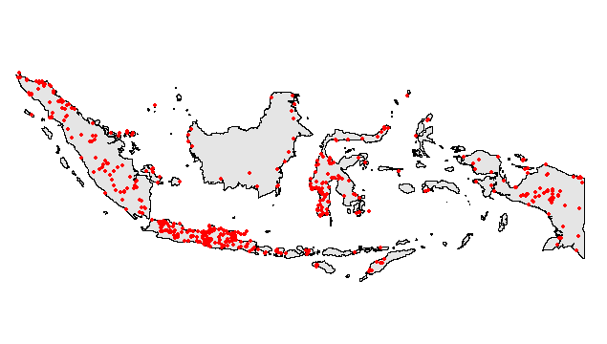
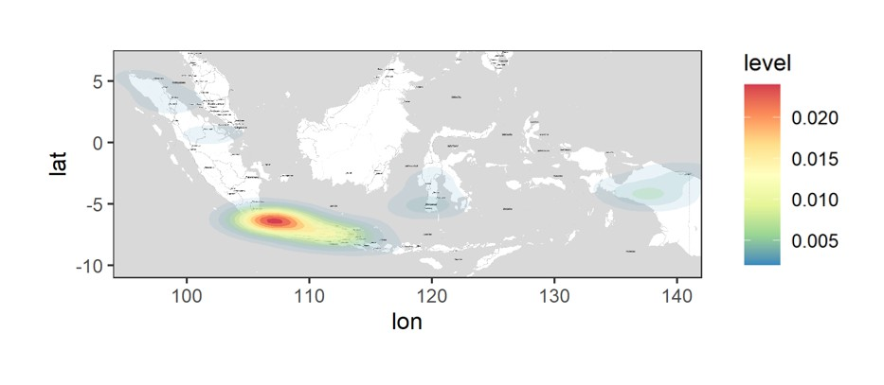
03. Processing – Persebaran Kasus

Slide 11
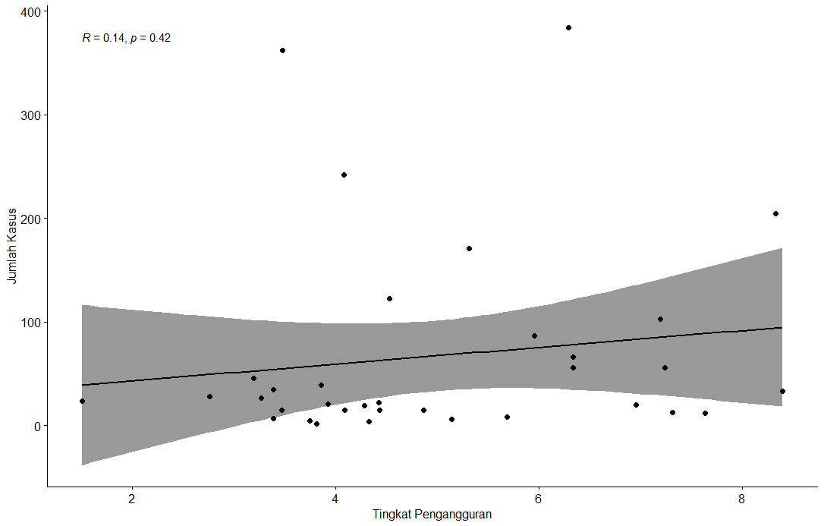
03. Processing: Correlation Tingkat Pengangguran* – Jumlah Kasus
Korelasi antara jumlah kasus dan tingkat pengangguran pada suatu provinsi tidak signifikan
Sumber: BPS
https://www.bps.go.id/dynamictable/2020/02/19/1774/tingkat-pengangguran-terbuka-tpt-menurut-provinsi-1986---2019.html

Slide 12
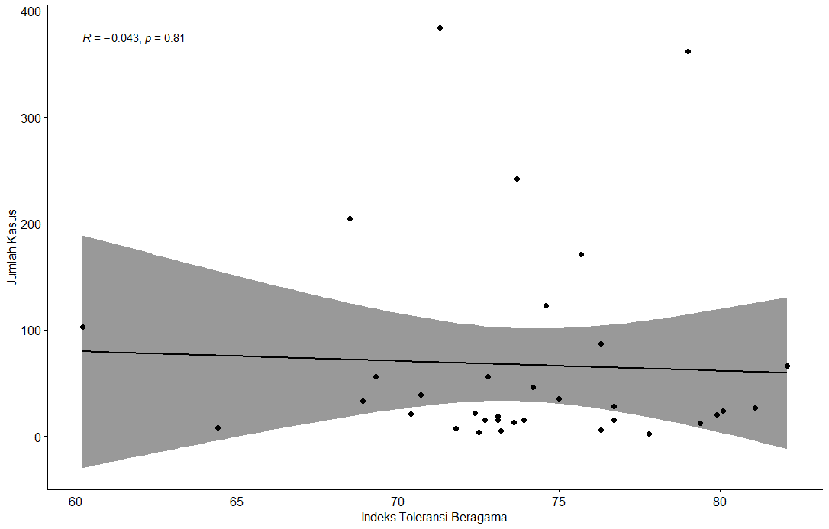
03. Processing: Correlation Indeks Toleransi Beragama* – Jumlah Kasus
Korelasi antara jumlah kasus dan indeks toleransi beragama pada suatu provinsi tidak signifikan
Sumber: Kementerian Agama
https://tirto.id/daftar-skor-indeks-kerukunan-beragama-versi-kemenag-2019-engH

Slide 13

04. Insight – For Government
[1]
Solution
Highly focus on increasing awareness of suicide bomb potential, mainly in Surabaya and Kampung Melayu. This type of violence significantly contributing to the number of fatalities
List 1-3 ways your company proposes to solve them.
[2]
Increase awareness of any violence potential, especially in Jakarta & Papua. The number of case is not driven by either economic or religious factors of a province.

